Slide 1

Scientific project
Optimizing and Interpreting CNN Models on the CIFAR-10 Dataset Using XAI Techniques
Nan AN
July 31,2024
Telecom Sudparis

Slide 2
Project Overview
Ⅰ.Data Exploration and Preparation
Ⅱ.Convolutional Neural Network
1.Baseline Model (VGG 3 Blocks)
2.Cross Validation for Basic Model
3.Improving Model
(1)Dropout and Data Augmentation and Batch Normalization
4.Model Evaluation
Ⅲ. XAI techniques
1.DeepSHAP
2.Layerwise Relevance Propagation
(1)LRP-0、LRP-ε、LRP-γ、Z-B rule
(2)LRP combination
Ⅳ. Metrics to Compare the Quality
Ⅴ. References and Resources

Slide 3
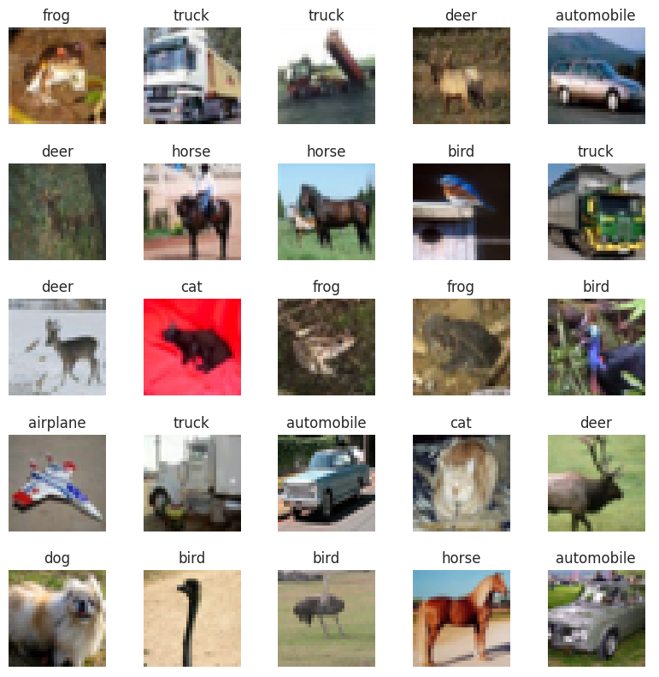
Part Ⅰ Introduce CIFAR-10
The CIFAR-10 dataset is made up of 60,000 color images, each sized 32x32 pixels. These images are divided into 10 different classes, with 6,000 images per class. Out of these, 50,000 images are used for training and 10,000 for testing.

Slide 4
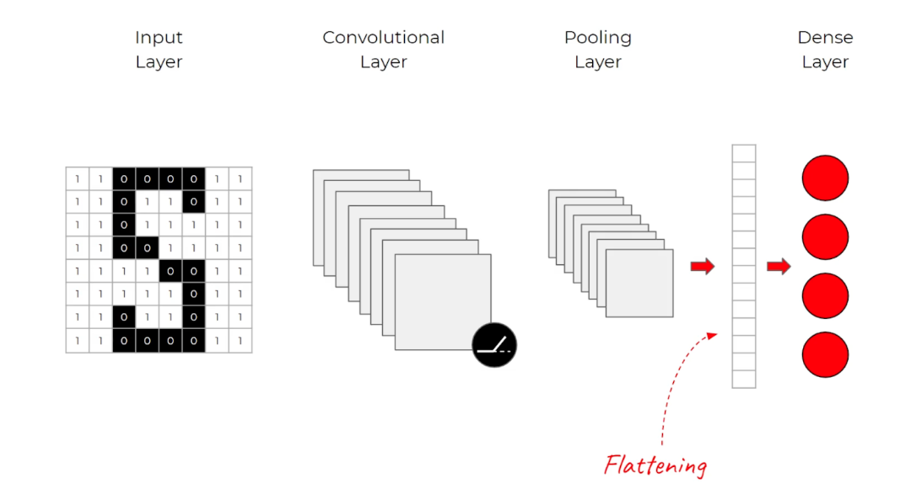
Part Ⅱ. Convolutional Neural Networks
Let’s outline the architectural anatomy of a convolutional neural network:
Convolutional layers: start with a kernel (matrix)
Activation layers: No “learning” happens in this layer. I used ReLU function.
Pooling layers: help control overfitting, it is essentially a dimensionality reduction.
Dense layers: take the flattened pixels as input, I apply a SoftMax function at the output

Slide 5
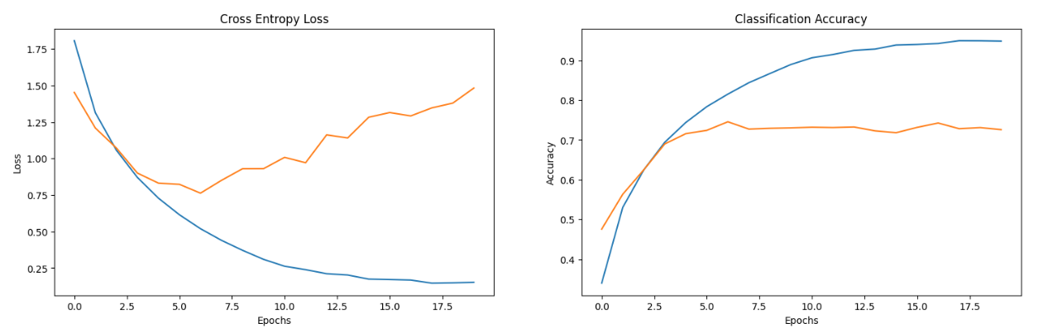
Ⅱ.1. Baseline Model (VGG 3 Blocks)
VGG-style network ^{[1]}
Three convolutional blocks, each containing two Conv2D layers followed by a MaxPooling layer
Training 50 epochs and set early_stoping
Training Loss
Validation Loss
Training Loss
Validation Loss
The accuracy of the Base Model is: 72.58%
The Loss of the Base Model is: 1.48
Validation loss is increasing a lot which means my model is overfitting. Lets try to reduce overfitting and increase accuracy.

Slide 6
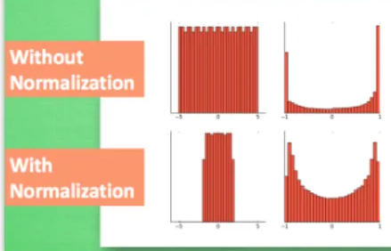
Ⅱ.2. Improving Model
conv_1_filter: 64
conv_2_filter: 64
…………
conv_6_filter: 256
dense_units: 192
learning_rate: 0.001
Cross Validation
1.prevent overfitting, improving the model's robustness(decrease loss value)
2. identify the optimal hyperparameters
Dropout is a regularization method
Data Augmentation applying random transformations like rotation, flipping, scaling.
Batch Normalization reduces the vanishing gradient problem by scaling data to a specific range.
input
output

Slide 7
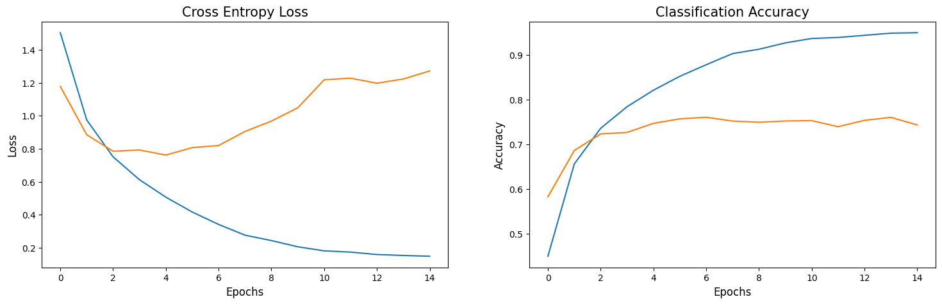
Ⅱ.3. Cross validation for basic model
Training Loss
Validation Loss
Training Loss
Validation Loss
The accuracy of the optimized model is: 74.75%
The loss of the optimized model is: 0.7621, the loss decreased compared by basic model

Slide 8
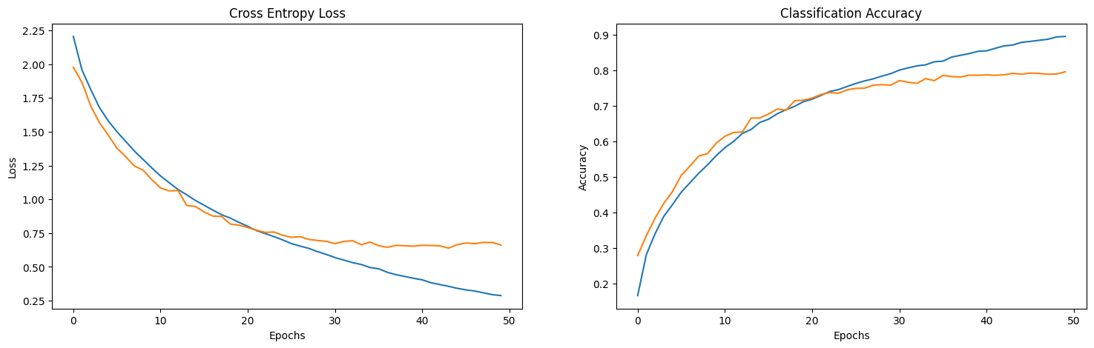
Ⅱ.4. Improving Model-Adding Dropout
Lets try to reduce overfitting and use Optimized hyperparameters
Training Loss
Validation Loss
Training Loss
Validation Loss
The accuracy of the Dropout Model is: 79.61%
The Loss of the dropout Model is: 0.66

Slide 9
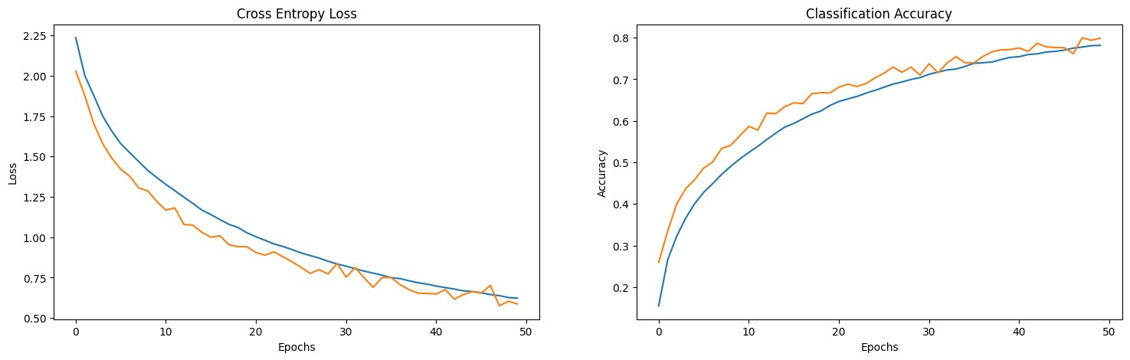
Ⅱ.4. Improving Model-Data Augmentation and Dropout
Training Loss
Validation Loss
Training Loss
Validation Loss
The accuracy of the Model is: 79.86%
The Loss of the Model is: 0.58

Slide 10
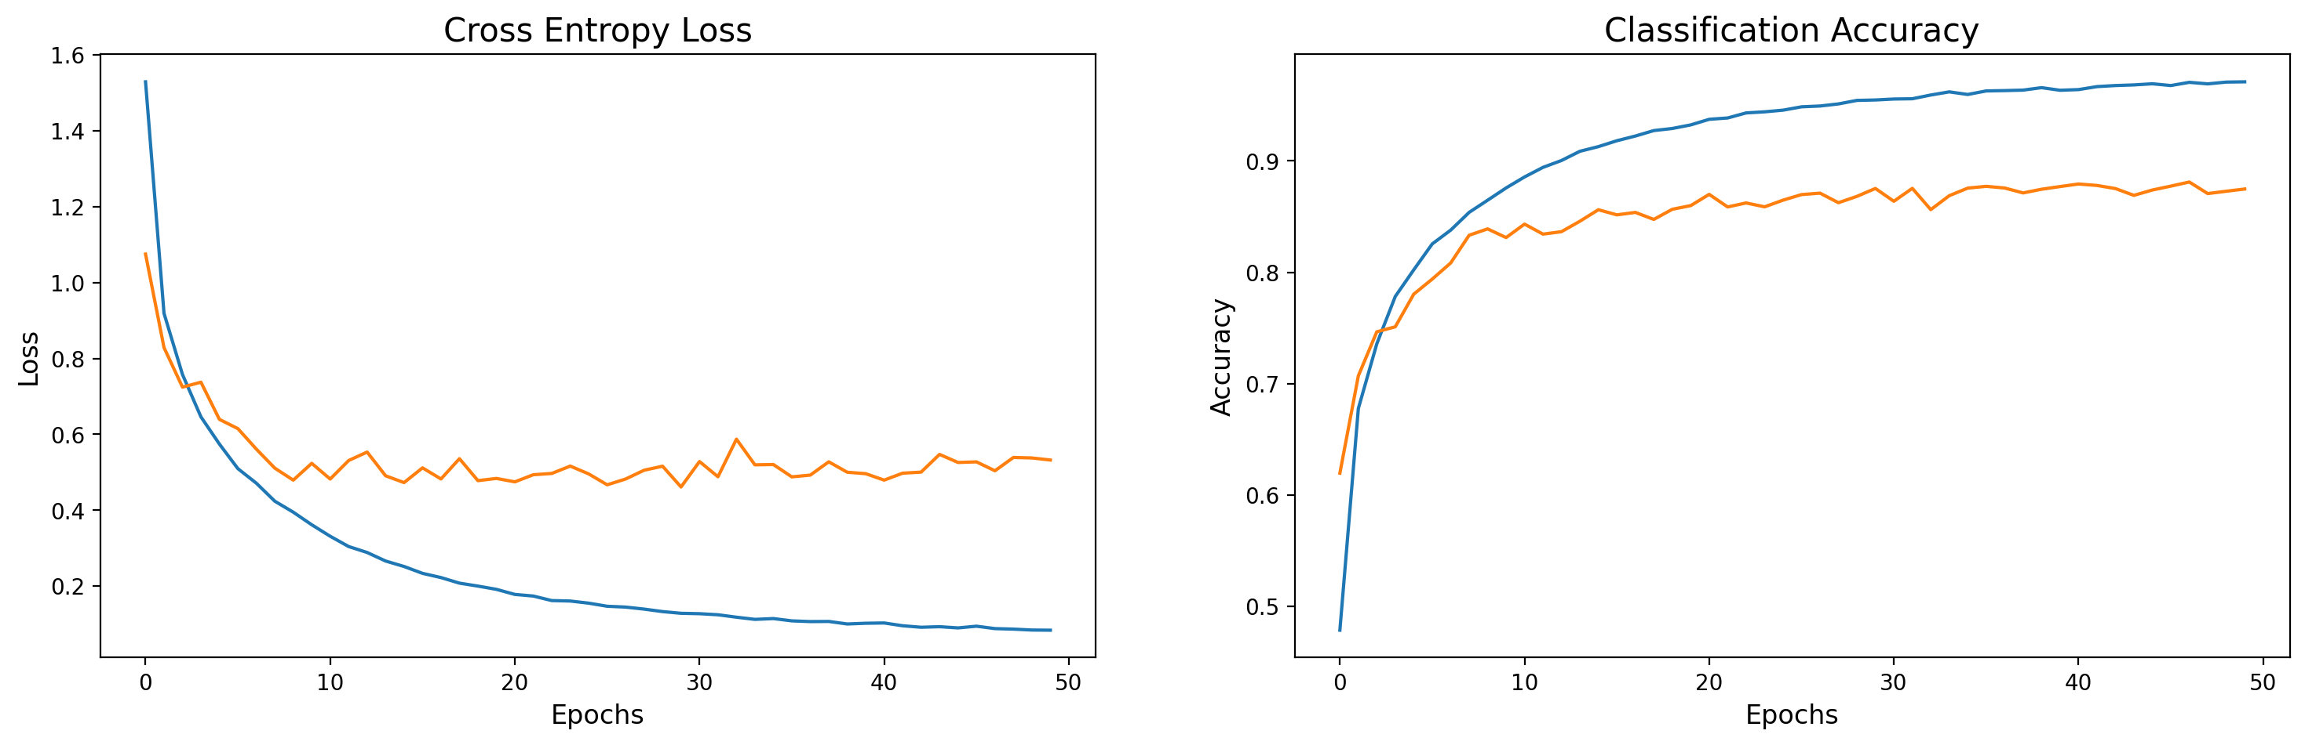
Ⅱ.4. Improving Model-Dropout and Batch Normalization
Training Loss
Validation Loss
Training Loss
Validation Loss
The accuracy of the Model is: 87.48%
The Loss of the dropout Model is: 0.5323

Slide 11
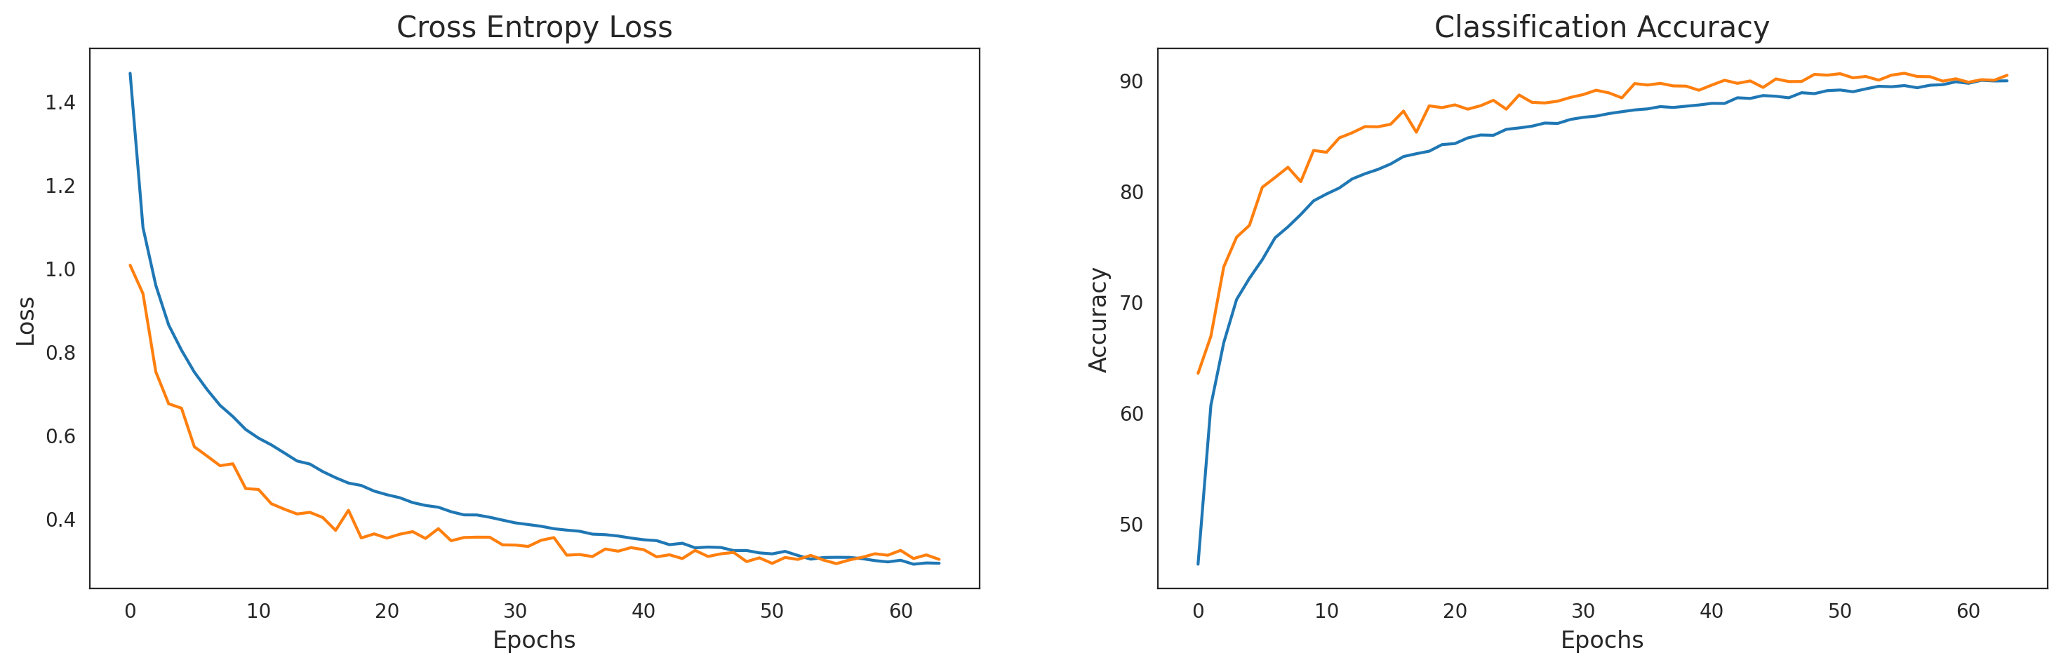
Ⅱ.4. Improving Model- Dropout and Data Augmentation and Batch Normalization
Training Loss
Validation Loss
Training Loss
Validation Loss
The accuracy of the Model is: 90.65%
The Loss of the Model is: 0.29

Slide 12
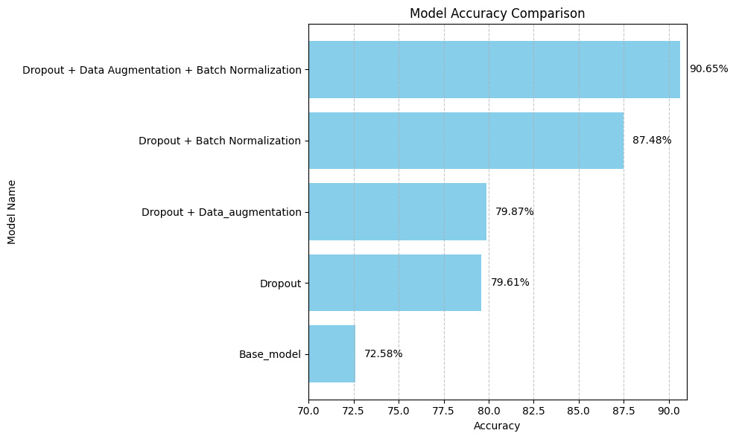
Ⅱ.5. Model Evaluation

Slide 13
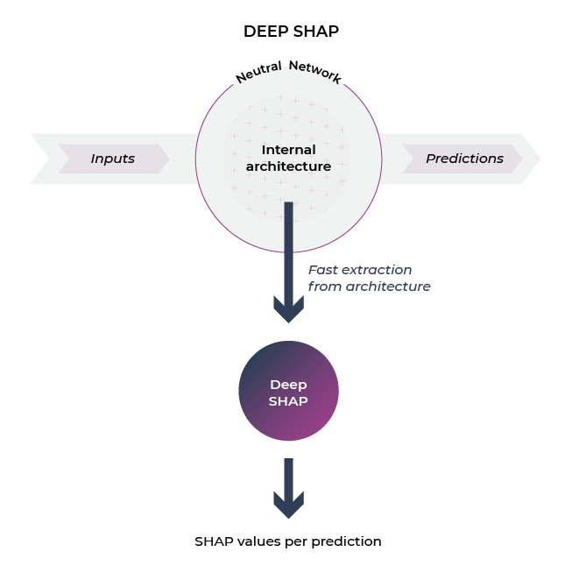
PART Ⅲ. XAI techniques - DeepSHAP
XAI provides insights into which features or parts of the input data are most influential in the model's predictions.
Deep SHAP is a high-speed approximation algorithm for SHAP values.
Deep SHAP builds on a connection with DeepLIFT described in the SHAP NIPS paper ^{[2]}. The basic principle is to calculate the contribution of each feature by comparing the model's output with and without the feature.

Slide 14
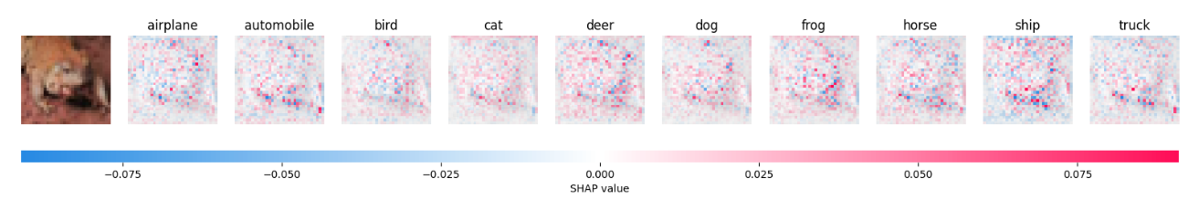
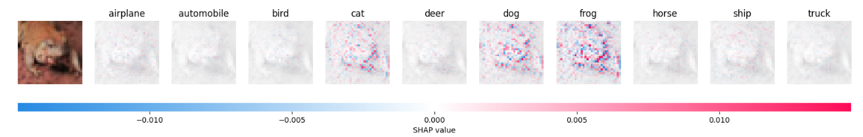
Ⅲ.1. Deepshap-optimize
complex and noisy.
After added a softmax function to the output layer^{[3] [4]}.
clearer and distinguishable
The softmax function converts the network's output values (logits) into a probability distribution in the interval [0, 1] . SHAP usually assume that the model output is a probability distribution
Tune parameters and choose the appropriate functions are important

Slide 15
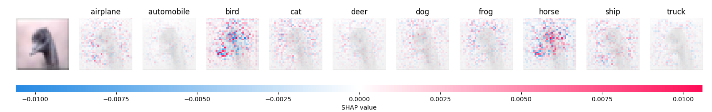
Ⅲ.1. DeepSHAP-Highlight Case
Bird with probability: 0.8446
Horse with probability: 0.1211
This image clearly demonstrates the role of XAI. The reason it is identified as a bird rather than a horse is that the bird's beak in this image is very sharp, and the positive relevance around the bird's beak is higher compared to the horse's heatmap. Therefore, the model classifies it as a bird.

Slide 16
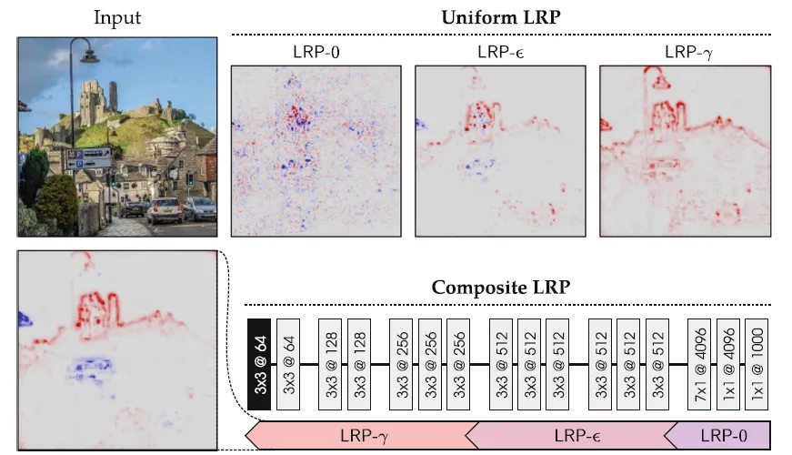
Ⅲ.2. XAI techniques – Layerwise Relevance Propagation
LRP-0: Keeps all features and weights, making the explanation too complex and noisy.
LRP-ε: Keeps only the most important features and weights, but is too sparse and hard to interpret.
LRP-γ: Keeps only positive features and weights, which is easy for humans to understand, but it can also show irrelevant parts, like highlighting a lamppost.
LRP-γ ← LRP-ε ← LRP-0^{[5]}: Combines these methods to keep important features and weights while removing many unimportant noises, providing a clear explanation.

Slide 17
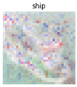
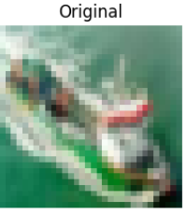
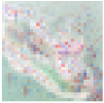
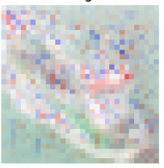
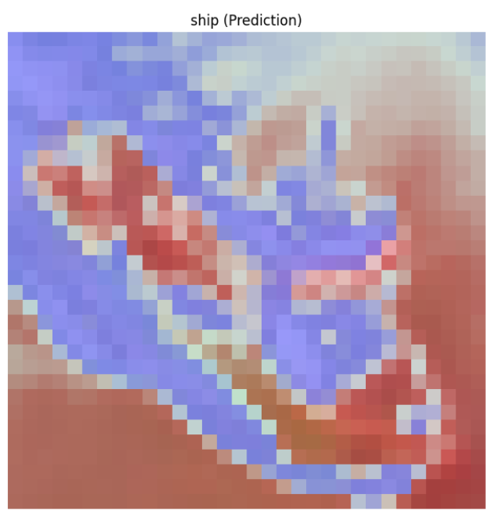
Ⅲ.2. XAI techniques -Layerwise Relevance Propagation
LRP-0
The explanation overly complex and noisy.
LRP-ε
Too sparse and not easy to interpret.
Prediction：ship
probability: 0.9984
LRP-γ
Relatively clear. For example, the top of the ship‘s cockpit and the middle part of the ship show positive relevance.
negative relevance
positive relevance
Too extreme, identifying noise like the sea surface as important features.
Z-B rule

Slide 18
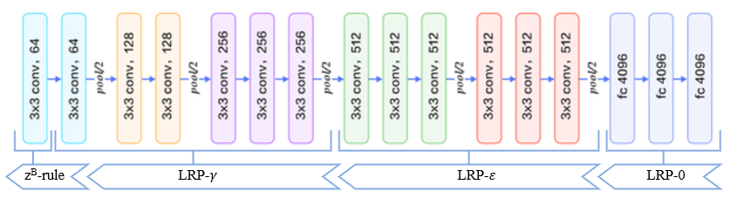
Ⅲ.2. Create a New LRP model- Combining Different Methods
This method references Gregoire Montavon (2021), LRP Tutorial, from TU Berlin Git ^{[5]}
and RositaRai (2024), LRP-model-investigation ^{[6]} .
Z-B Rule for the earliest convolutional layers. (index 0-5)
LRP-γ for intermediate convolutional layers. (index 6-11)
LRP-ε for deeper convolutional layers and the first fully connected layers. (index 12-17)
LRP-0 for the final fully connected layers. (index 21)

Slide 19
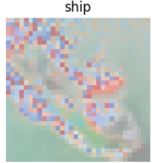
Ⅲ.2. Effectiveness of new combining LRP model
Prediction：ship
probability: 0.9984
It can be observed that the top part of the ship's cockpit and the outline of the ship appear in red, while the waves caused by the ship are in blue, corresponding to noise or irrelevant background features.
negative relevance
So In deep、complex model and large image tasks, it is important to choose the appropriate LRP method. We can leverage the strengths of each approach by combining different methods
positive relevance
Notes:
We can see that the effect of combining LRP model is clearly better than applying each one individually.

Slide 20
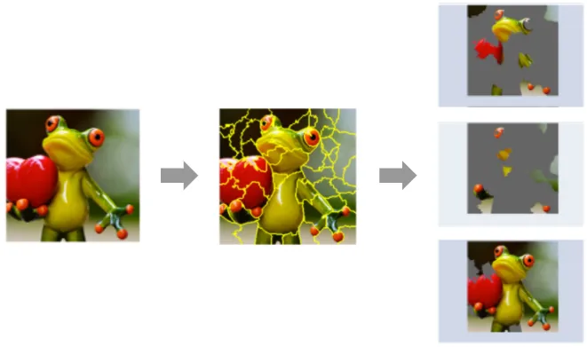
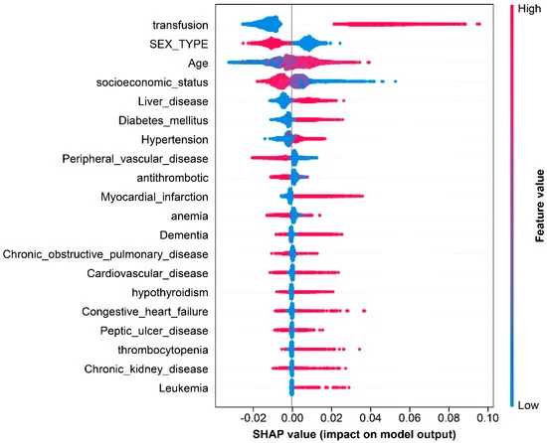
Part Ⅳ. Metrics to Compare the Quality of DeepSHAP and LRP --Local and Global Explanations
Local explanations aim to explain the prediction of a small subset. A local explanation highlight which parts of the image were most important for classifying it as a frog.
Global explanations aim to provide an overview of the model’s behavior. For example, in assessing the risk of wound infection, SHAP values can be used to explain the impact of different features.

Slide 21
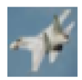
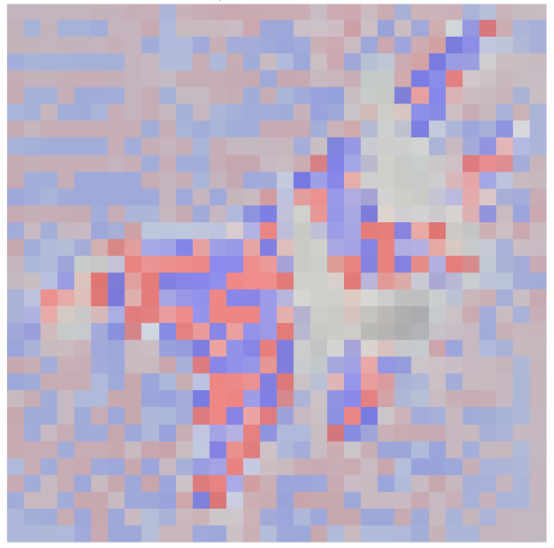
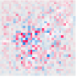
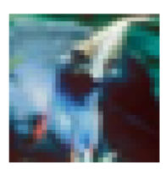
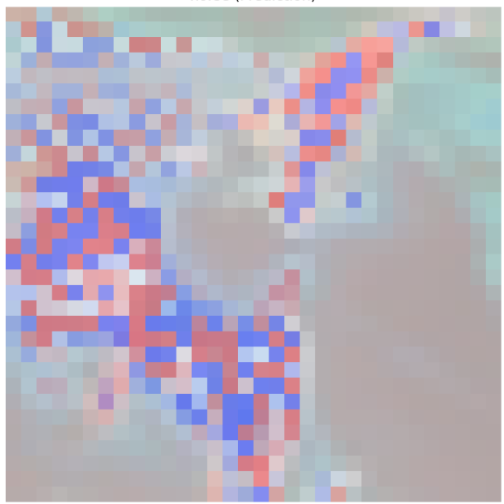
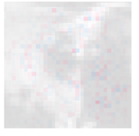
Ⅳ. 1. Local Explanation
Original: airplane(0.9894)
prediction: airplane(0.9894)
LRP method
DeepSHAP
For local explanations, applying LRP in CNNs is superior to DeepSHAP.
Even for misclassified images^{[7]}, LRP can detect more feature contributions in the original label
Original: bird (0.079243)
Prediction horse(0.5777)
DeepSHAP of bird
LRP of bird

Slide 22
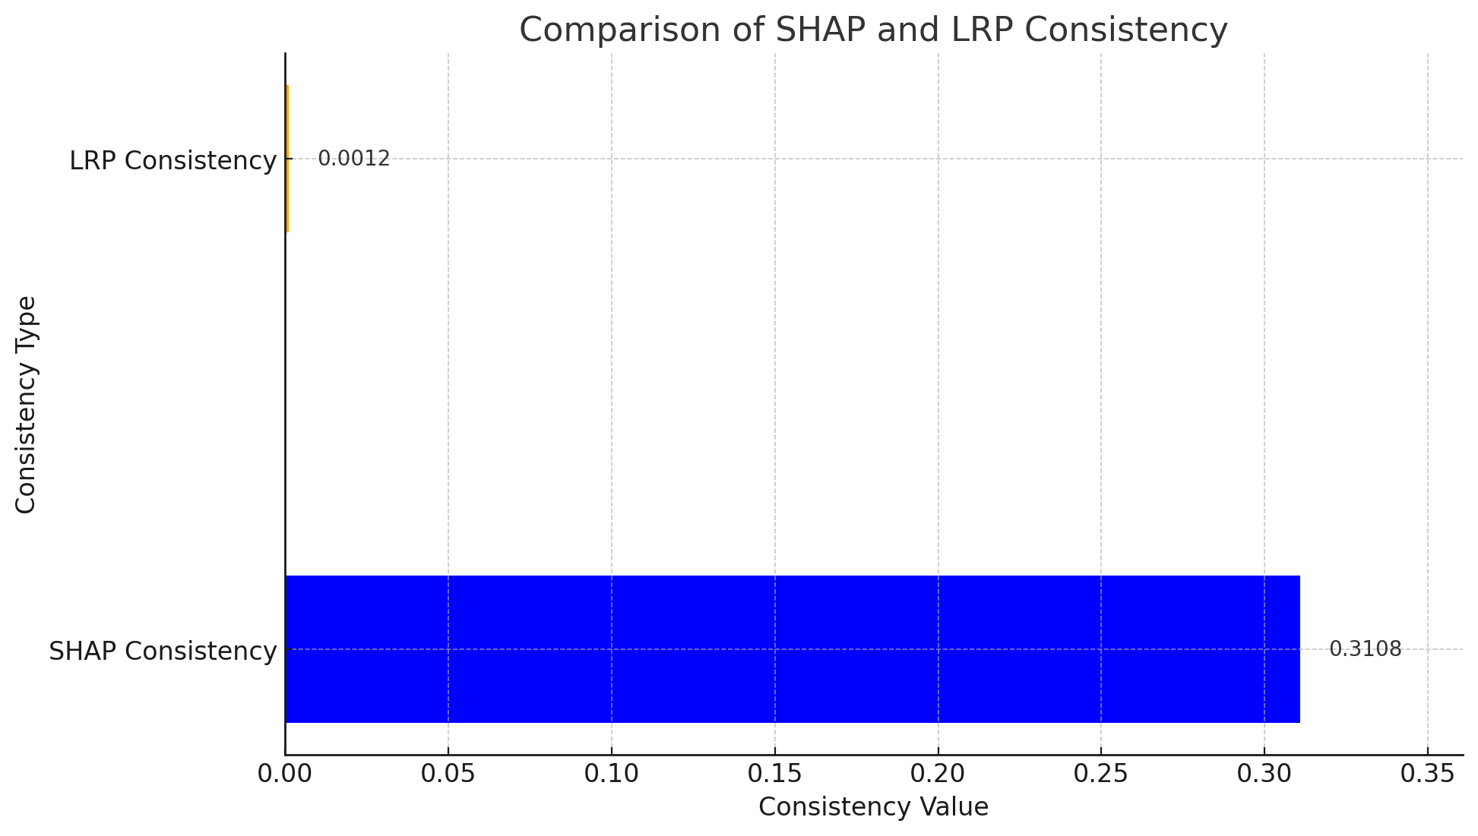
Ⅳ. 2. Global Explanation-Consistency
Consistency refers to the ability of an explanation model to maintain consistent output explanations when faced with minor changes in input data.
DeepSHAP’s higher consistency,
it means it’s better at figuring out how different features impact the model’s decisions.

Slide 23
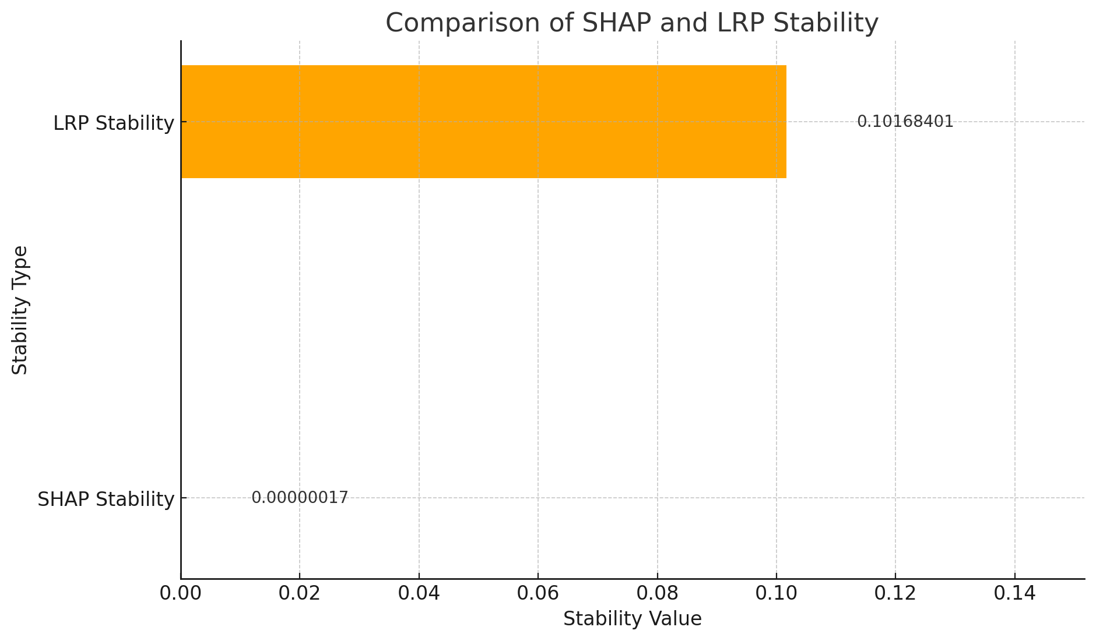
Ⅳ. 2. Global Explanation-Stability
Stability refers to the ability of an explanation to remain similar even if there are small changes in the input data
LRP get higher stability than Deepshap. In cifar10, this makes it useful when you need understanding how each pixel in an image contributes to the prediction

Slide 24
Ⅳ. 3 Pros and Cons of DeepSHAP and LRP
 | DeepSHAP | Layerwise Relevance Propagation
Advantages: | High Consistency | High Stability
 | Model-Agnostic | Effective for Deep Models
Disadvantages | Low Stability | Low Consistency
 | Complex Interpretations | Complex Implementation
Overall, compared to DeepSHAP, LRP is more suitable for my project

Slide 25
Part Ⅴ. References and Resources
[1] Sachin Patil. (2023). CIFAR-10: Image Classification CNN. Retrieved from https://www.kaggle.com/code/sachinpatil1280/cifar-10-image-classification-cnn-89
[2] DeepLIFT: Shrikumar, Avanti, Peyton Greenside, and Anshul Kundaje (2017).. "Learning important features through propagating activation differences." arXiv preprint arXiv:1704.02685
[3] Lundberg, S. M., & Lee, S.-I. (2017). A Unified Approach to Interpreting Model Predictions. arXiv. https://doi.org/10.48550/arXiv.1705.07874
[4] SHAP GitHub. (2024). SHAP: SHapley Additive exPlanations (Version 0.46.0). Retrieved from https://github.com/shap/shap
[5] Gregoire Montavon. (2021). LRP Tutorial. Retrieved from https://git.tu-berlin.de/gmontavon/lrp-tutorial
[6] RositaRai. (2024). LRP-model-investigation. Retrieved from https://github.com/RositaRai/LRP-model-investigation
[7] G. Montavon, A. Binder, S. Lapuschkin, W. Samek, K.-R. Müller. (2019). Layer-wise Relevance Propagation: An Overview. Explainable AI: Interpreting, Explaining and Visualizing Deep Learning, Springer LNCS, vol. 11700.

Slide 26
Thank you for you attention!
31/07/2024

